Slide 1


CitiManager User Guide
Treasury & Trade Solutions | Commercial Cards
View PIN
May 12, 2020
External

Slide 2
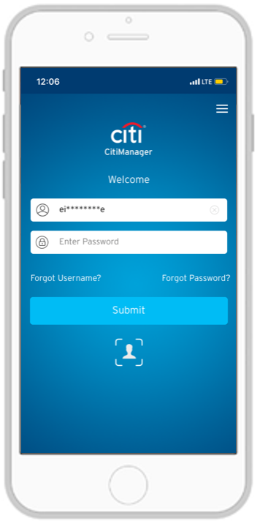
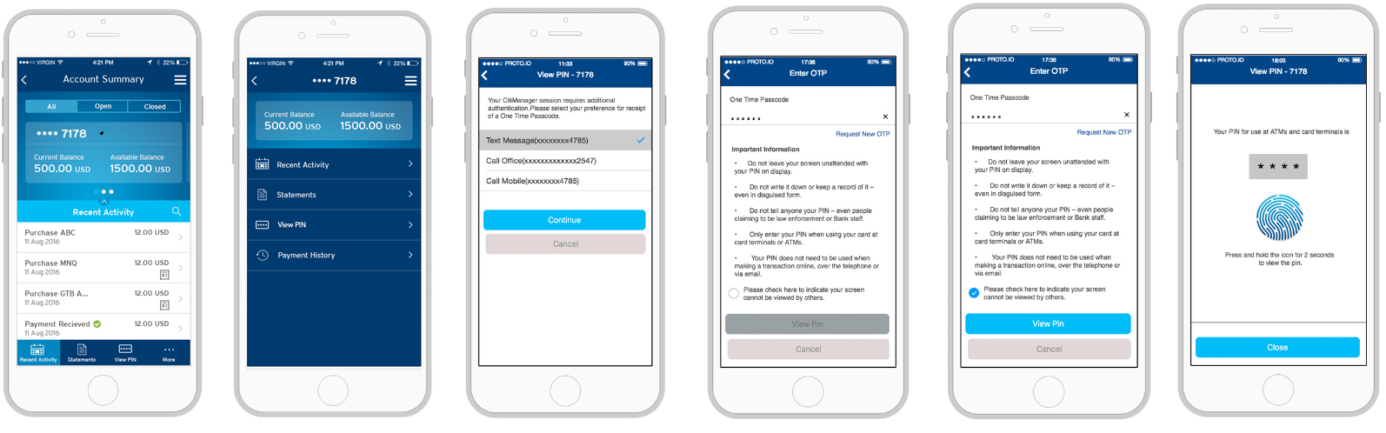
Login
Cardholder (CH) logins to CitiManager mobile app
Cardholder selects View PIN menu item
User ID & Password / Biometrics
Challenge question
Via Bottom Navigation
OR
Via More Menu

Slide 3






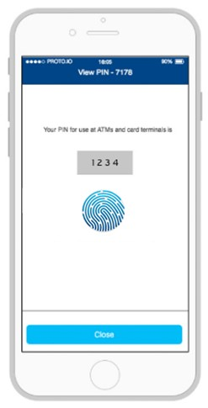
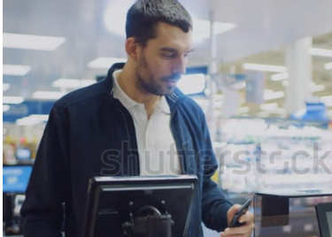
Cardholder is at Point of Sale and is Prompted to Enter Transaction PIN.
Scenario 1: Registered CitiManager User WITH Phone Number in User Profile
CH selects desired OTP delivery mechanism and destination
CH enters the OTP that was delivered via voice call or text message
If text message was selected, OTP auto-populates from messages.
CH reviews the important information displayed on the screen.
By checking the box, CH confirms that no one else can view their screen.
CH taps button to View PIN.
If OTP was entered correctly, the CH will be able to view their transaction PIN by holding down the fingerprint icon for 2 seconds.
CH enters the correct PIN and completes the transaction

Slide 4
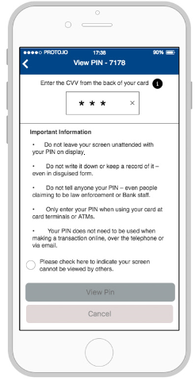
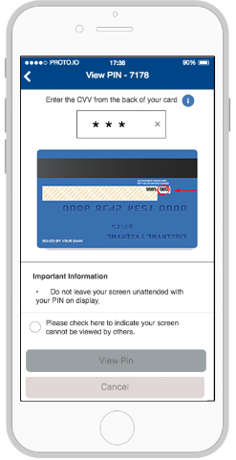
Cardholder is at Point of Sale and is Prompted to Enter Transaction PIN.
Scenario 2: Registered CitiManager User WITHOUT Phone Number in User Profile*
CH leverages the contextual help to identify location of CVV code
CH enters the CVV on the back of their card.
CH reviews the important information displayed on the screen.
By checking the box, CH confirms that no one else can view their screen.
CH taps button to View PIN.
If OTP was entered correctly, the CH will be able to view their transaction PIN by holding down the fingerprint icon for 2 seconds.
CH enters the correct PIN and completes the transaction
*This flow is not applicable for users in the EMEA region as users cannot login to CMM without a phone number associated with their profile.

